Slide 1
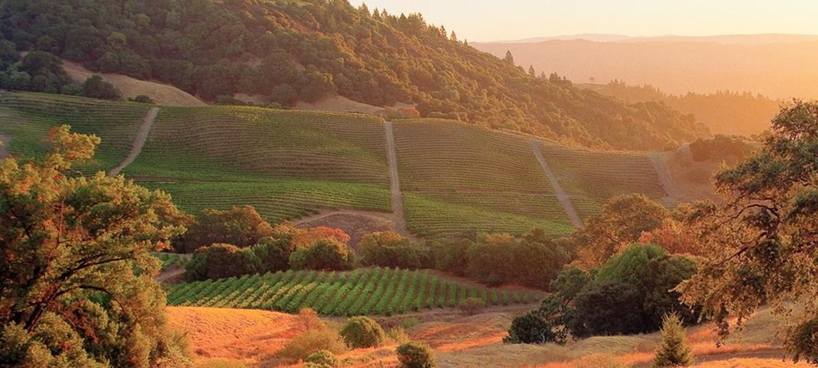
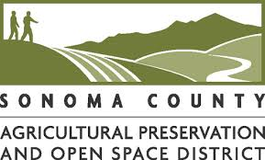
Conservation-smart planning:
Asserting Natural and Working Lands in Land Use Scenario Development and Decisions
Liz O’Donoghue
Carrie Schloss

Slide 2
Outline
Current trends in land use
The conservation module: a new tool to encourage sustainable growth
Conservation Module in action

Slide 3
Conserving the lands and waters on which all life depends
1M 600 120M 69
YEARS MEMBER SCIENTISTS ACRES CONSERVED COUNTRIES
Notes:
Our mission is…
Traditionally a land trust, we’ve protected over 120 million acres world wide

Slide 4
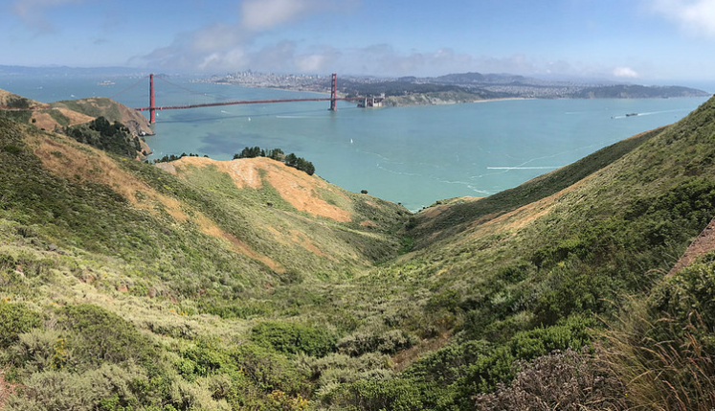
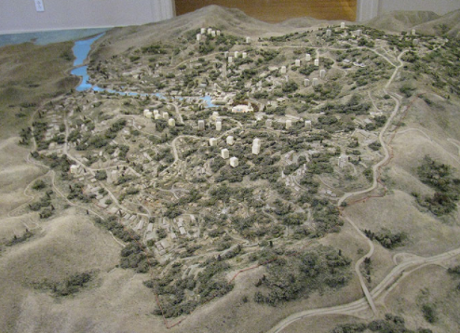
Conservation successes in California
Attribution 2.0 Generic (CC BY 2.0) by albedo20 via Flickr
Success can be measured as what would have happened if we didn’t act
California Historical Society exhibit
Notes:
Many of our conservation successes have been here in CA. Has anyone been to the Marin headlands? For those of you who have you may recognize the view in the picture on the right. It is a beautiful area to hike or bike with gorgeous views of the ocean, the bay, and the golden gate bridge.
What you may not know is that that area was all slated for development into a sprawling suburb called Marincello in the 1970’s. A model of that development is pictured here on the left. The suburb gate posts were already built, and the entrance road was already graded when TNC purchased the land from the developer It is now part of Golden Gate NRA which hosts 16 million visitors annually.
We can measure conservation success as what would have happened if we didn’t act.

Slide 5
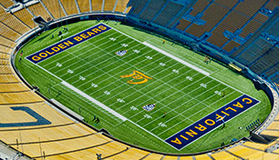
Every 2.5 minutes the American West loses a football field worth of natural area to human development
Conservation science partners 2016
Notes:
That is what was happening then, lets take a look at the challenges we are facing now. Recently a report entitled the Disappearing west was released. This report exposed the alarming rate at which the west is losing its natural land to human development.
Every 2.5 minutes…
In the time that we are talking here today we’ll have lost 18 football fields to development

Slide 6
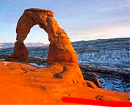
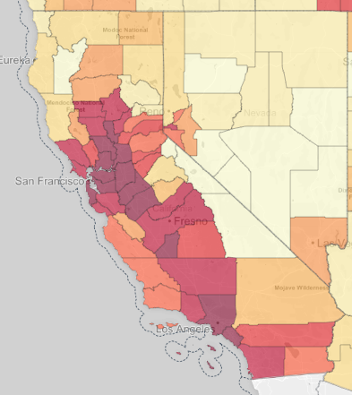
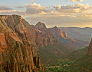
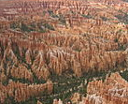
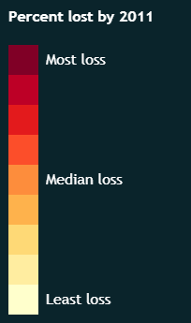
Square Miles Lost to Urban Sprawl 2001-2011
Conservation science partners 2016
Notes:
Most of the natural lands that are lost are due to urban sprawl, and in the decade 2001-2011 California was leader in the conversion of natural lands to urban sprawl. California lost over 800 square miles of natural lands to development. That is more than the land area of Arches, Bryce, Zion, and capitol reef national parks combined!

Slide 7
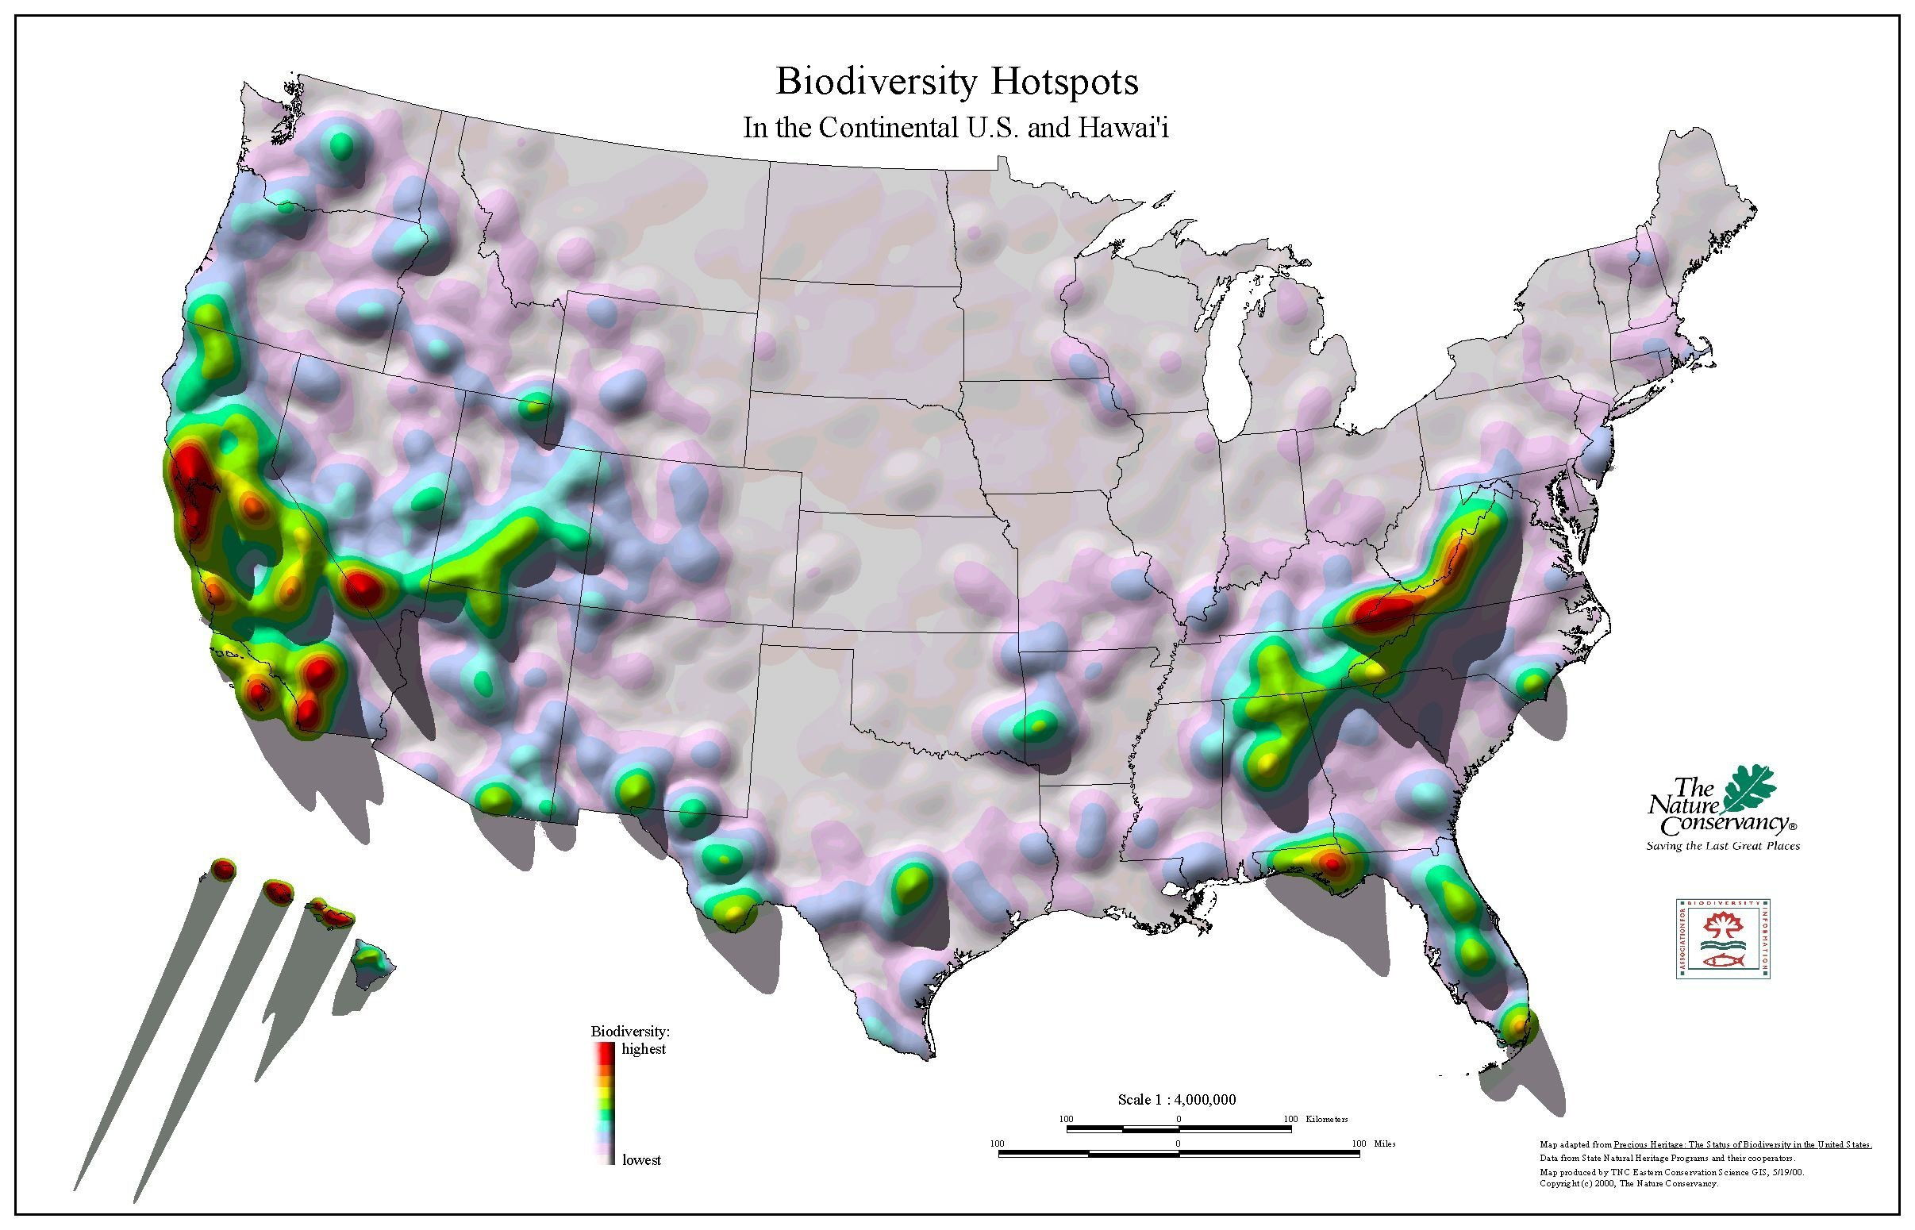
Biodiversity
Highest
Lowest
Notes:
This is particularly problematic because CA is a global biodiversity hotspot. That means that the CA is home to enormous diversity of plants and animals including plants and animals that are found no where else. These areas also have a diversity of ecosystems and that means there are a lot of services that nature provides in these areas. At the nature conservancy we aren’t just trying to protect land, we want to protect land that supports both biodiversity and the ecosystems that we depend on and we often focus on these hotspots.

Slide 8
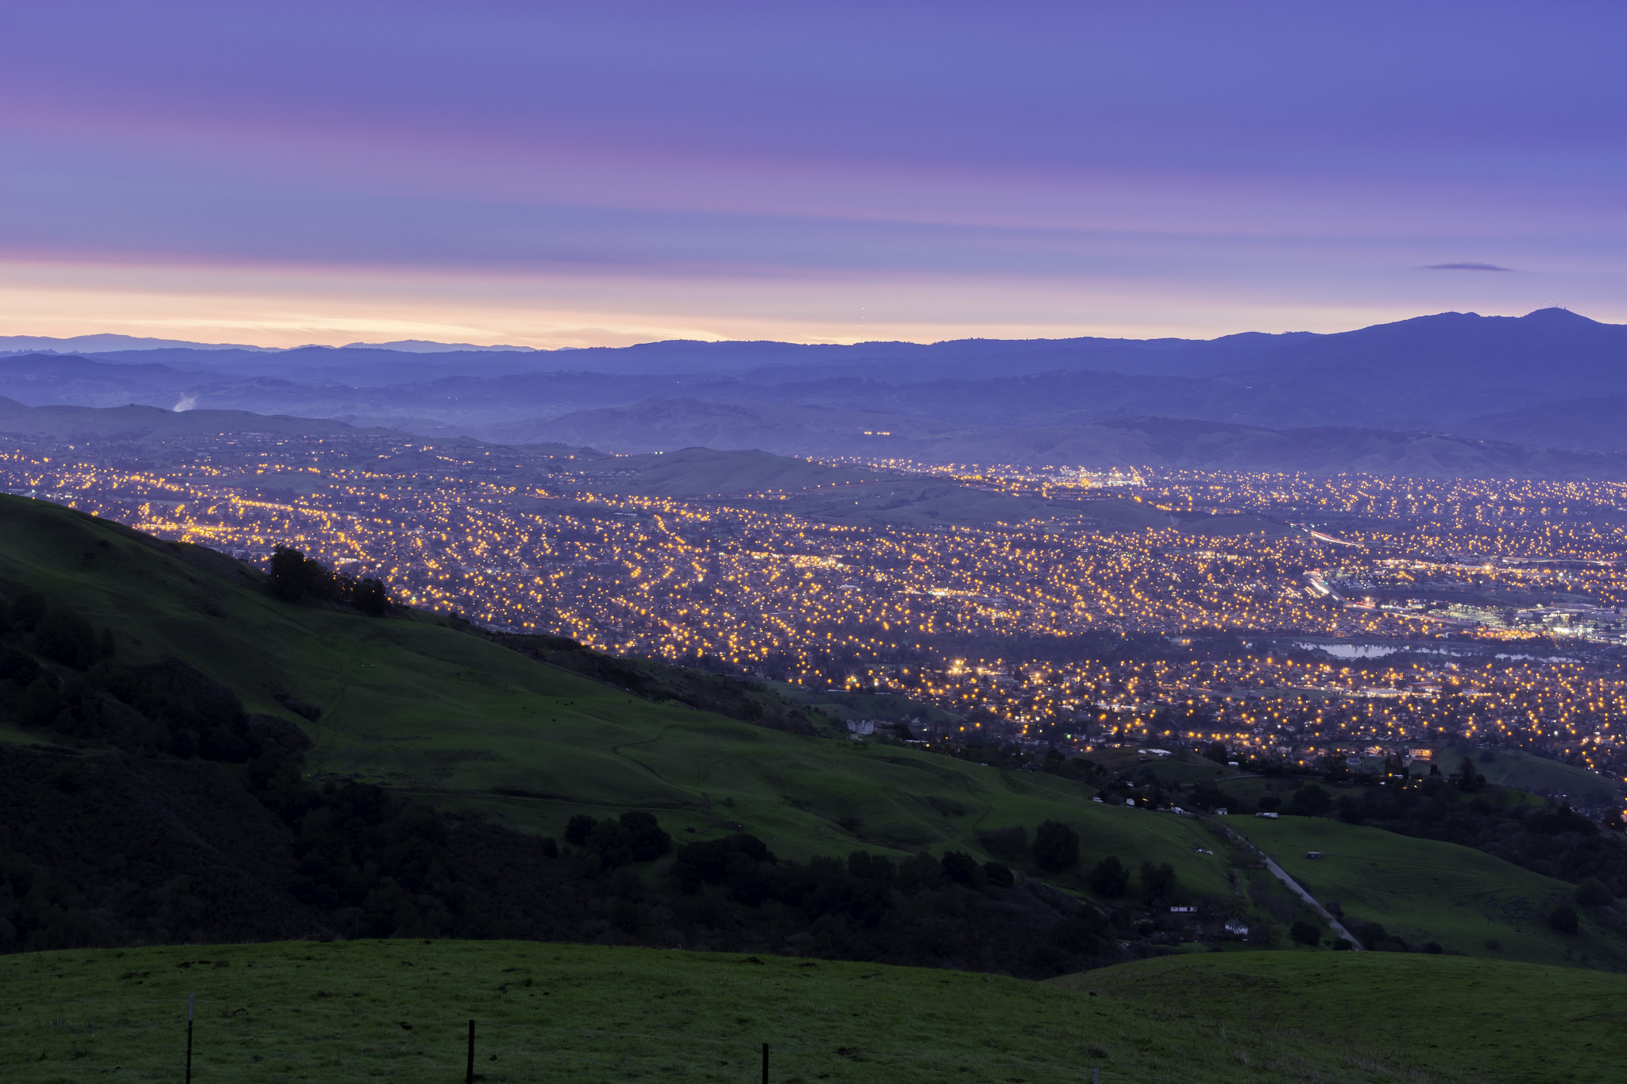
California is still growing…
10 million more people by 2050
How can conservation keep pace with this scale of growth?
How can we accommodate growth sustainably and still protect California’s vibrant natural and agricultural resources?

Slide 9
Protect More Natural Land
Spend Less Money
More resources,
to protect more land
+
=
Notes:
Let’s take a step back and look at a really simple conceptual equation. We want to protect more land in order to keep pace. If we can find ways to do that where we can spend less money, we will have more resource to protect more land. We are continuously innovating on ways to meet this challenge.

Slide 10
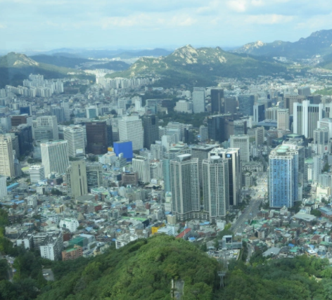
Photo: Andrew Amiet
Is open space designated as a park?
Or….. protection through zoning and smart growth by avoiding sprawl?
Notes:
Image on left - Seoul south korea

Slide 11
Can we transform the driver of the loss of natural lands into a driver for conservation of natural lands?

Slide 12
Growth is planned

Slide 13
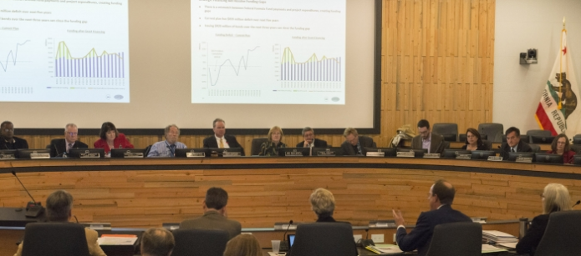
It all happens on Tuesdays…
County General Plans
Regional Transportation Plans
LAFCO decisions

Slide 14
Scenarios allow you to ask what if?
What if growth is characterized by the historic pattern of sprawl?
What if growth is limited to the urban growth boundaries?
What if growth is concentrated in just the major cities?
Icon made by Freepick from flaticon.com
Notes:
Carrie starts

Slide 15
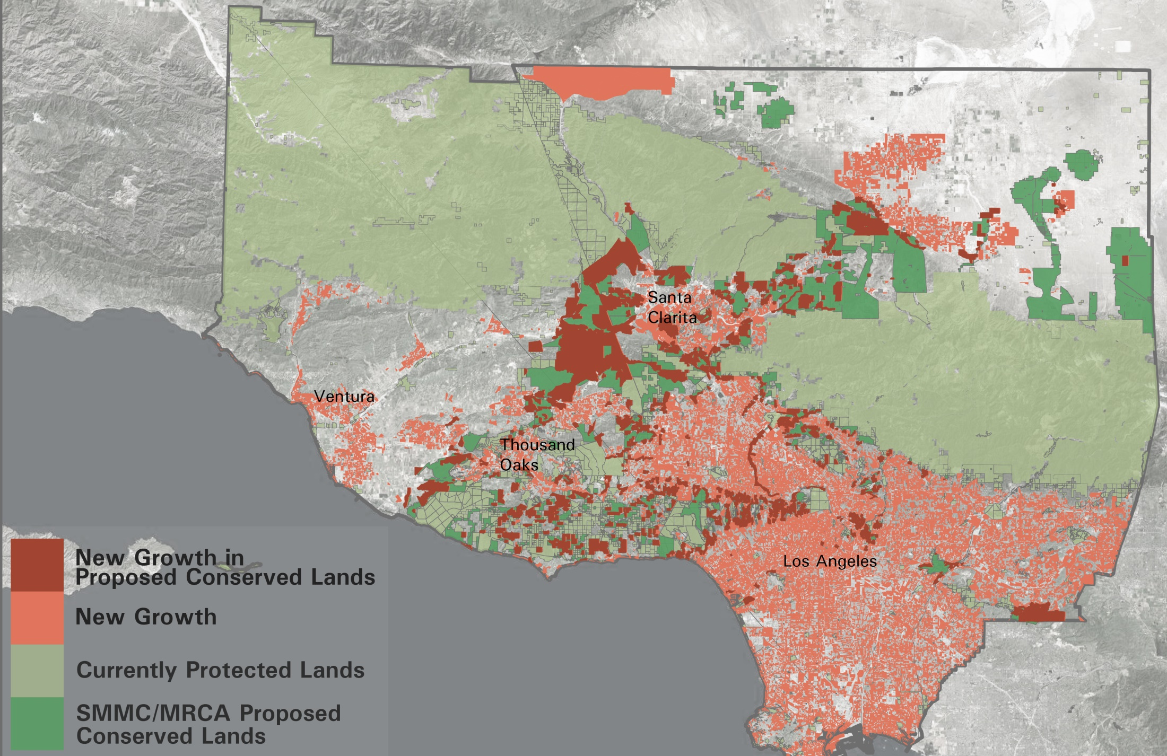
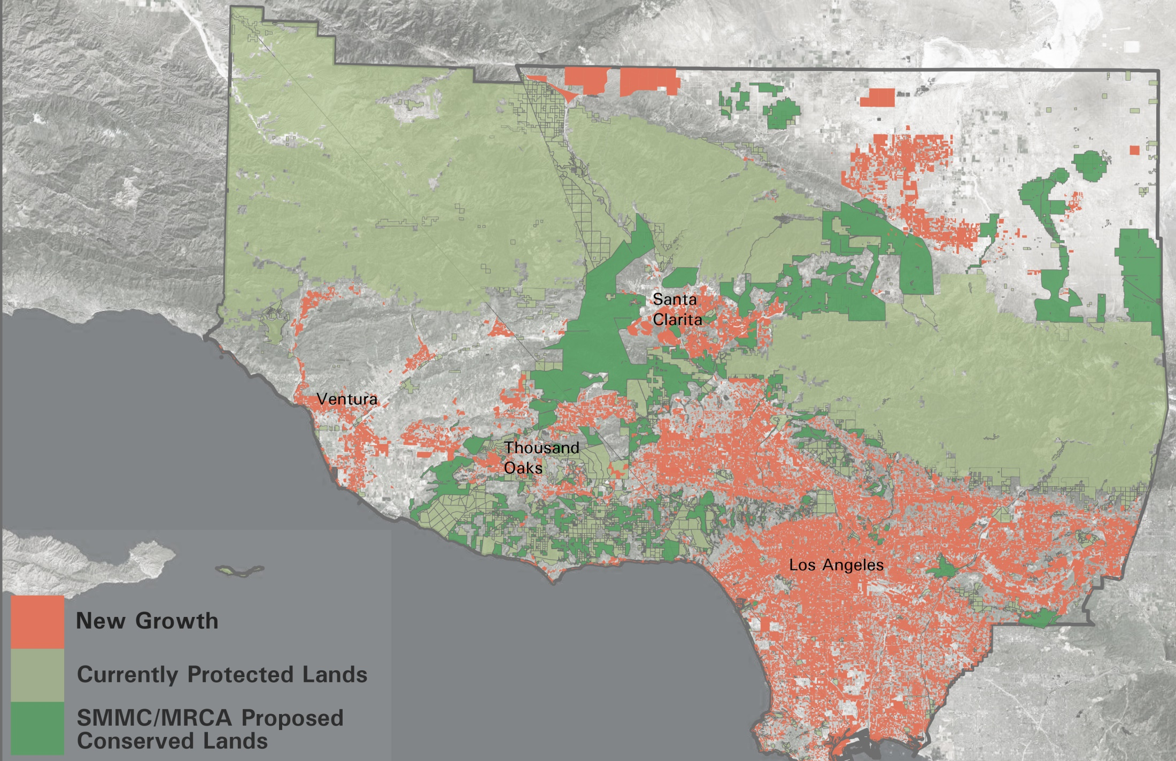
What if growth avoids conservation priorities?
UF in action: Santa Monica Mountains Conservancy
Notes:
Growth can also be planned to avoid conservation priorities. Lets take a look at a real world example. Here, future growth in the LA region that followed historic growth patterns would result in new growth in areas the Santa Monica Mountains Conservancy has identified as priority lands for protection. What if that same growth were to be allocated as infill into an already urbanized landscape.

Slide 16
What do these development patterns mean for household costs?
Icon made by Freepick from flaticon.com

Slide 17
What do these development patterns mean for building water use?
Icon made by Freepick from flaticon.com

Slide 18
Built environment metrics
Notes:
The problem is that nature is not here.

Slide 19
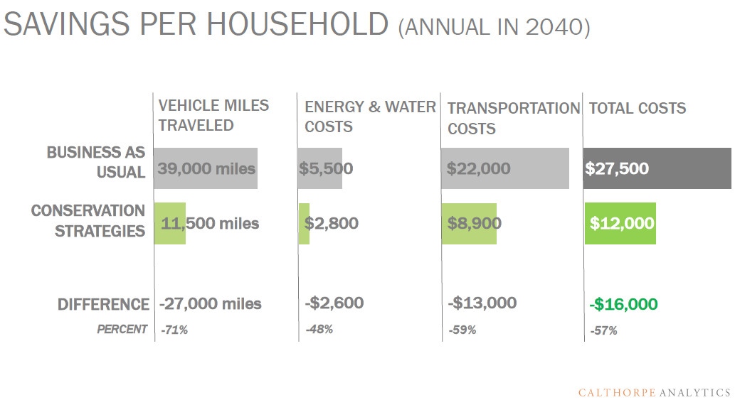
What if growth avoids conservation priorities?
Notes:
Using our real-world example outside LA – we can see that not only did avoiding sprawl avoid developing the Santa Monica Mountains Conservancy priority areas, but also – would reduce house hold costs. And…

Slide 20
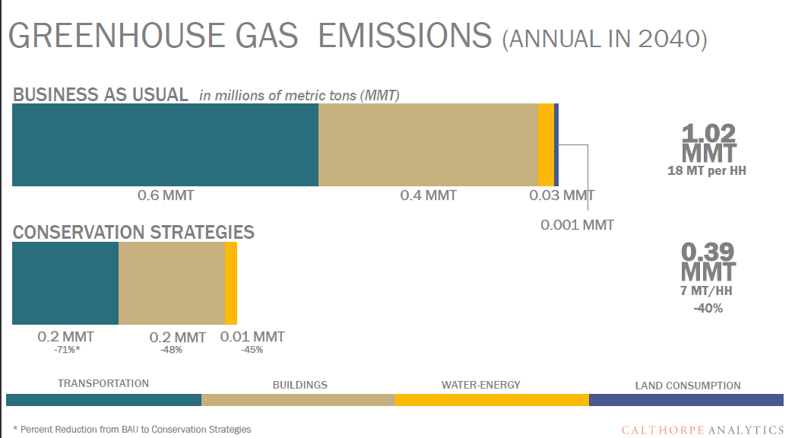
Santa monica mtns results
What if growth avoids conservation priorities?
Notes:
Save greenhouse gas emissions from the transporation, building, and water sectors, helping the region to meet its GHG reduction goals. But we know that these built environment indicators still aren’t capturing the full GHG reduction potential of the conservation scenario – because it still isn’t quantifying the carbon sequestered and stored in natural lands.

Slide 21
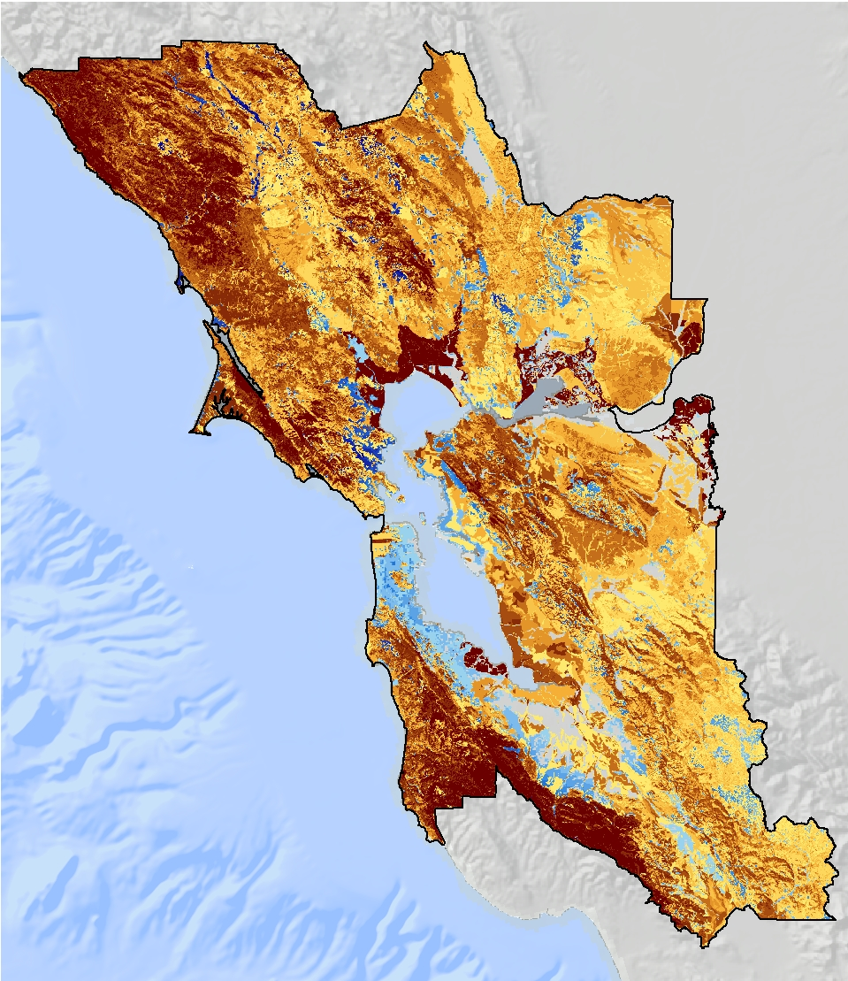
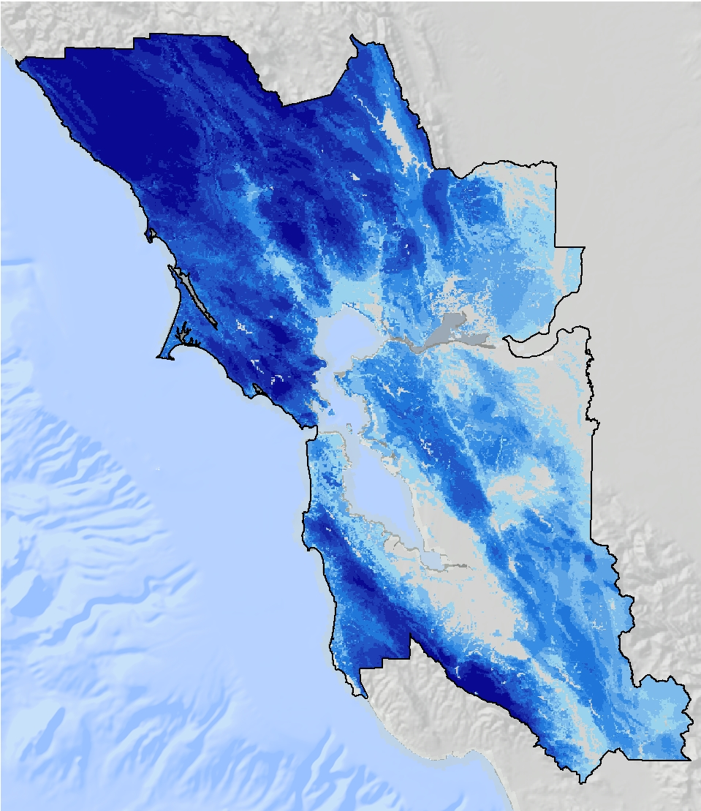
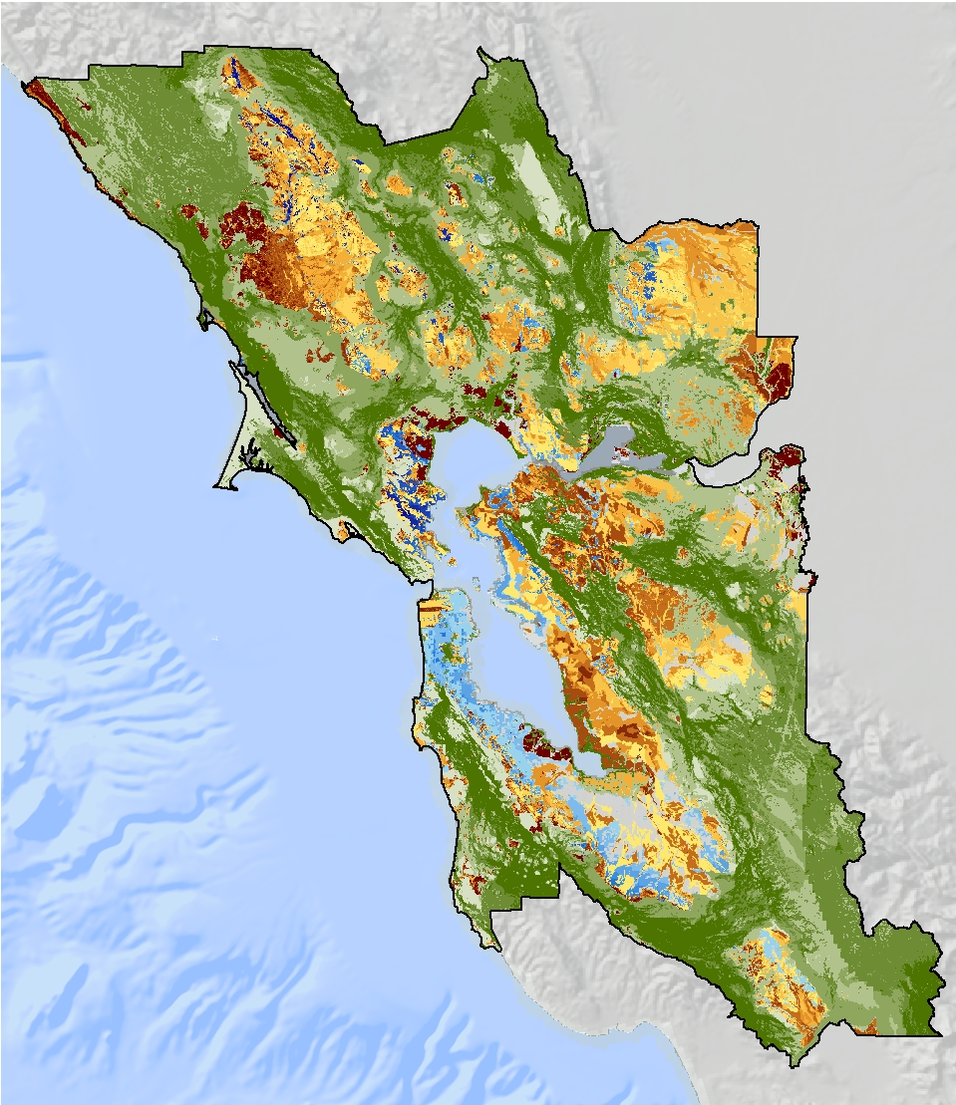
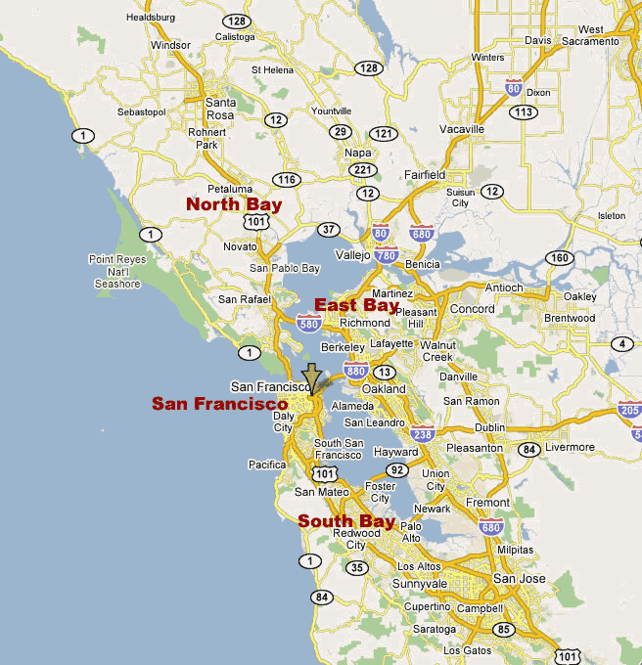

Slide 22
Elevating Conservation
Metrics
Water
Habitat
Agriculture
Carbon
Conservation Module
Notes:
Develop metrics that change the process of decisions making. That elevate conservation so decision makers a a more complete picture that doesn’t just include the built environment, but the natural environment as well and so that conservation has a seat at the table.
The good news is that people have never been so receptive to this information as they are now. The other good news is we have a LOT of data on where natural resources are on the landscape. The challenge is to make it easy to interpret, easy to use, and get it in front of planners early in the planning process.

Slide 23
The Conservation Module
Conservation Module
Water
Habitat
Agriculture
Carbon
Land Use Change Scenarios
Notes:
We built the conservation module to do just that! Our hypothesis is that if planners have the information IN the tools that they are already using and the information is easy to interpret and use, they will make better decisions for conservation and will have the more complete suite of information in support of sustainable growth
Lets step back and talk about how we developed it.
Easy to understand
Added value to decision makers
By revealing the benefits to the community

Slide 24
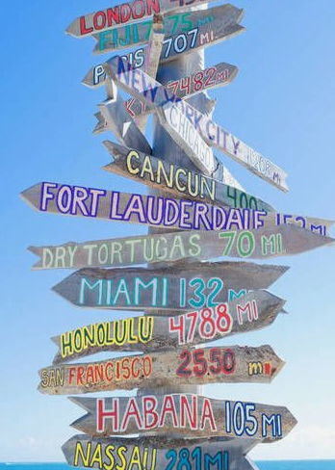
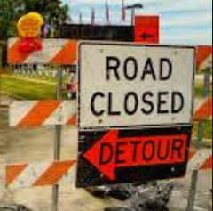
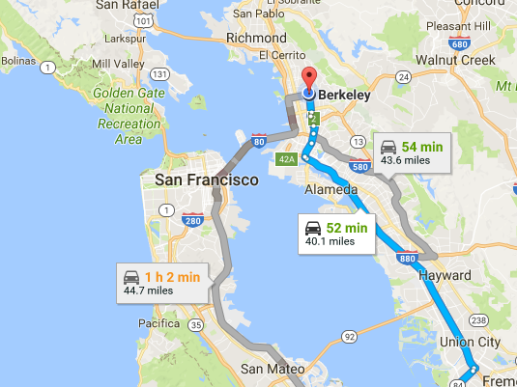
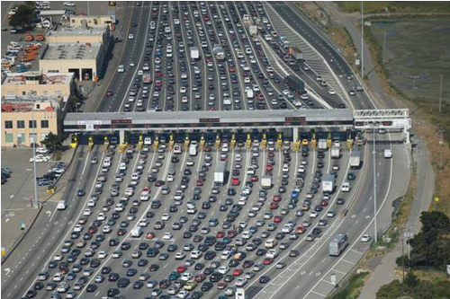
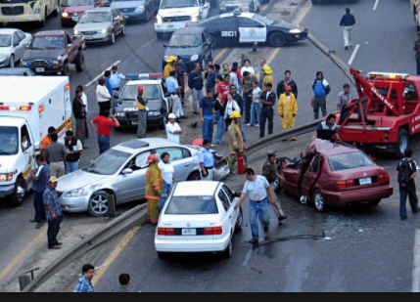
Scenario Planning Tools
Notes:
Here’s what we were going for…

Slide 25
Scenario Planning Tools

Slide 26
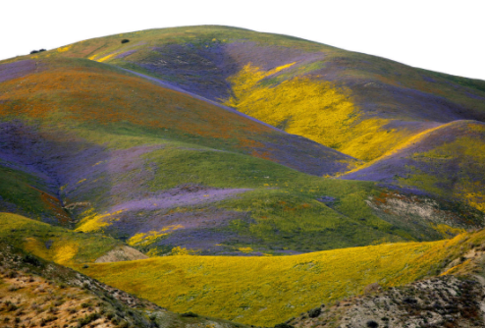
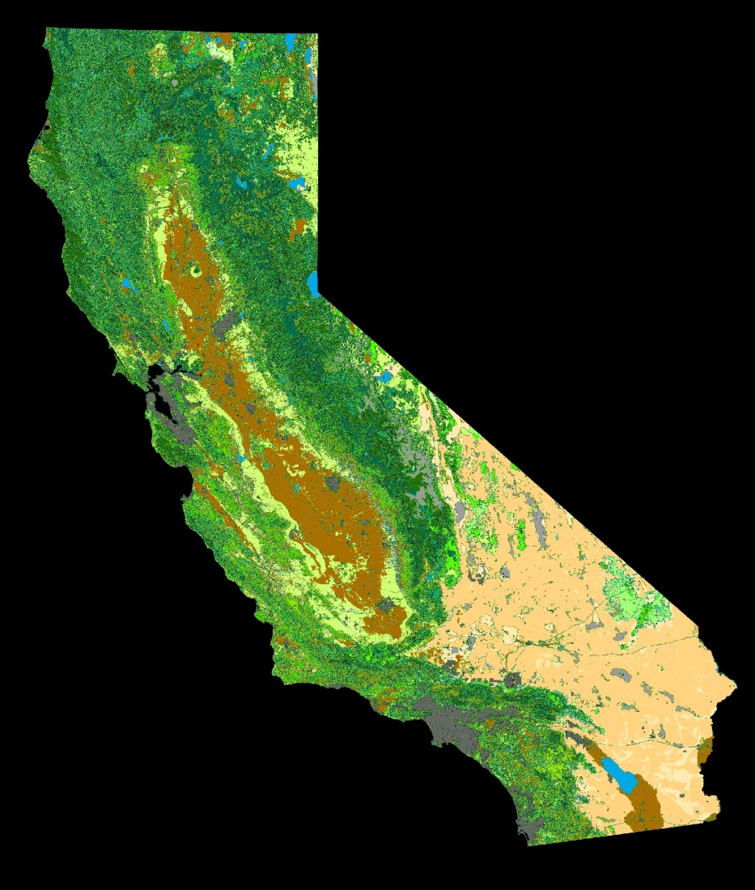
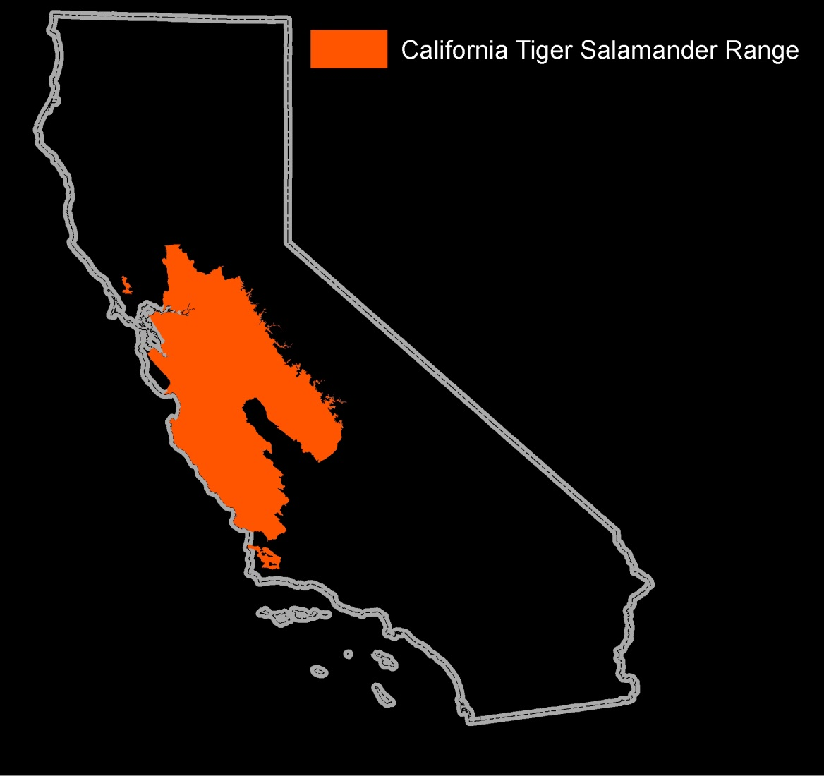
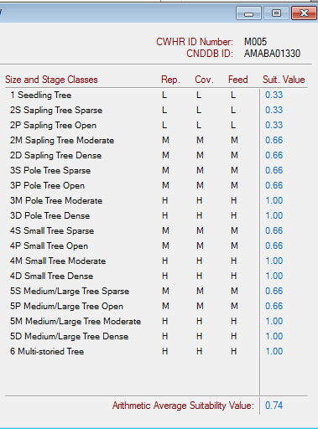
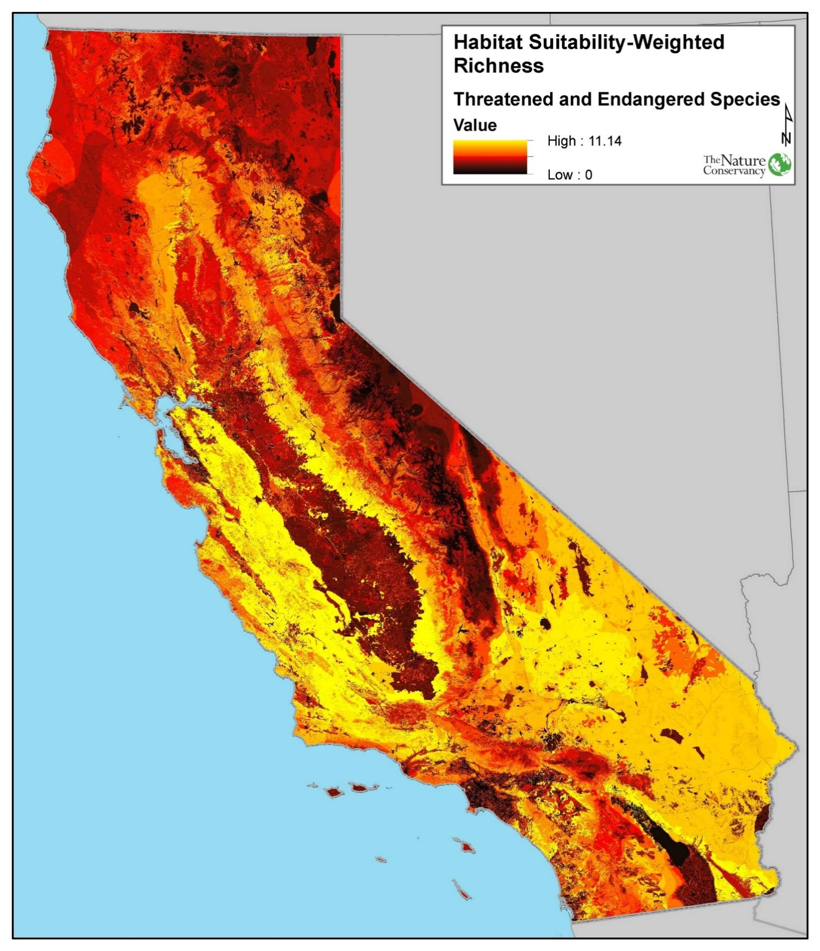
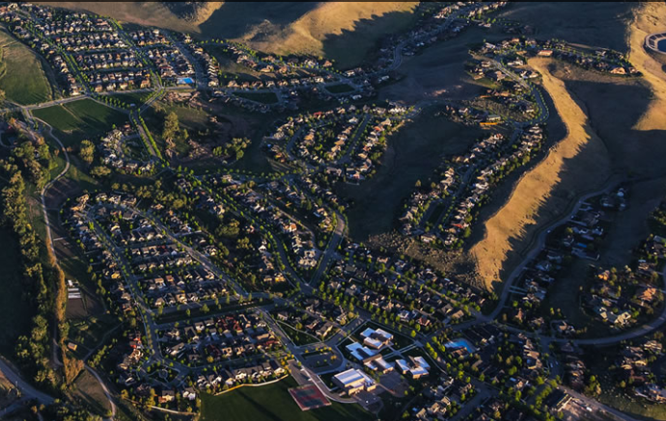
Notes:
We wanted to do the same thing with the conservation module. We wanted to take development scenarios and find a way to synthesis all of the data, vegetation data, range maps, habitat suitability information, species distribution models – into really simple, interpretable, and influential metrics.

Slide 27
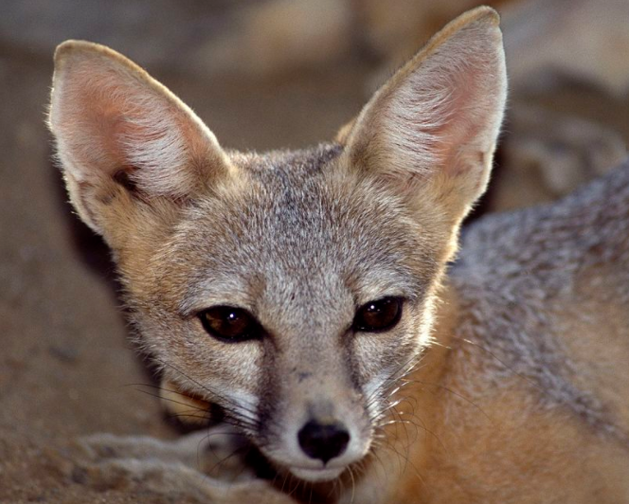
10,000 acres of degraded habitat
Photo Source: CDWR
Notes:
Such as this. This guy can influence decision makers. First, because he is adorable. But also because he is federally endangered and therefore any development in his habitat require mitigation – which is expensive. A solar company in the Mojave spent 56 million dollars moving desert toirtoises. So understanding where these protected species are in the early planning stages, is also good business decision.

Slide 28
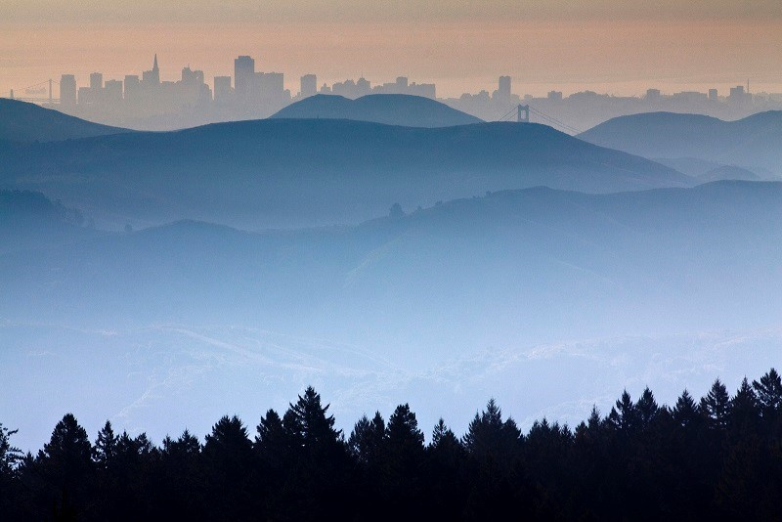
Conservation Module in Action
Plan Bay Area
Results Summary
Notes:
About a year ago the Metropolitan Planning Commission released the draft scenarios for plan bay area. When the sceanrios were released, there was no information about the impacts to natual or agricultural land. So, greenbelt alliance – a really impressive local organization that focuses on how the Bay Area handles growth with the goal of protecting open space, worked with Calthorpe Analytics to run the plan bay area sceanrios through the conservation module.

Slide 29
Scenarios accommodate: 2.1 million people 820,000 households 1.3 million jobs
Growth within boundaries
Sprawl
Growth within Urban Growth Boundary
Icon made by Freepick from flaticon.com
Notes:
The bay area needs to accommodated 820000 additional households and 1.3million additional jobs. Remember those people around the conference table, they have to make a decision about the patterns of development that accommodate this growth.

Slide 30
Sprawl Growth within boundaries
Notes:
The sprawl scenario has the footprint of a whole new san Francisco.

Slide 31
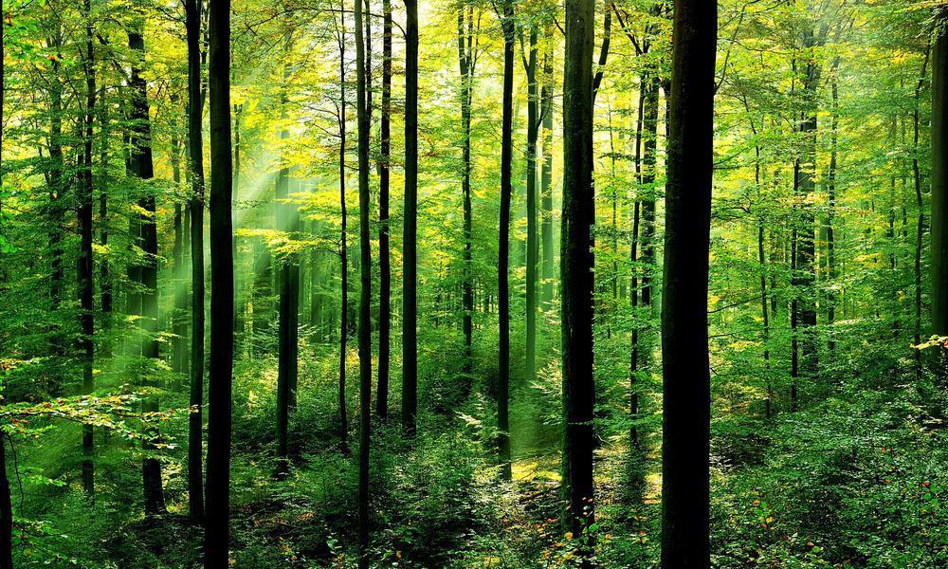
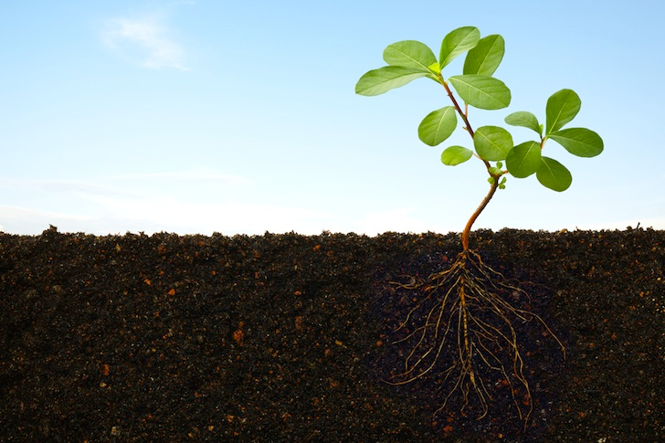
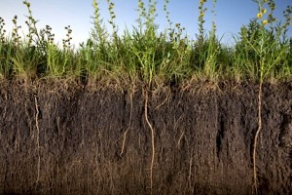
Carbon Storage and Sequestration

Slide 32
Carbon Stored
Carbon Emitted
CO₂
CO₂
CO₂
CO₂
CO₂
CO₂
Notes:
Carbon dioxide in the atmosphere sequesters carbon, converting it into the the woody biomass of trunks and branches and sending it through its roots to be stored as organic matter in soils. Vegetation acts as a pump that pumps CO2 out of the atmosphere. It is one of the few tools we have for fighting climate change. When the vegetation is removed from the landscape due to the development of natural lands – we lose that tool and the potential to remove carbon from the atmosphere moving forward, but also we the carbon that was stored in the branches and trunks and in the soils for decades is emitted back into the atmosphere.

Slide 33
Land protected from compact growth has climate change implications
equivalent to getting 112,000 cars off the road!
Equal to
164,150 passenger vehicles per year
Equal to
51,639 passenger vehicles per year
Sprawl Growth within boundaries

Slide 34
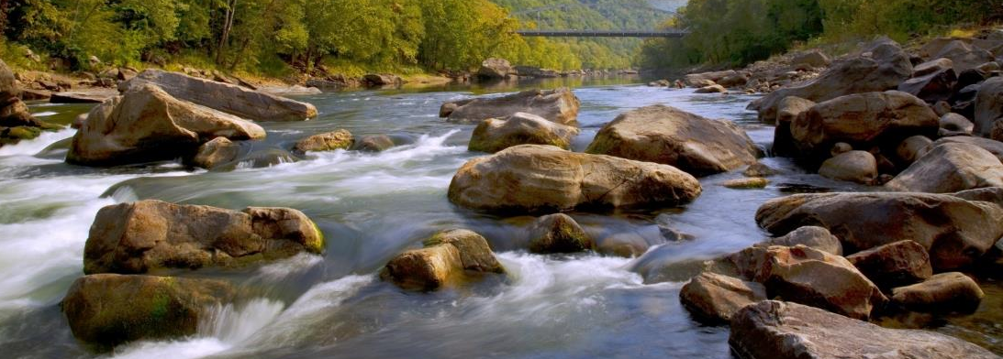
Groundwater Recharge
Water Supply and Quality Impacts

Slide 35
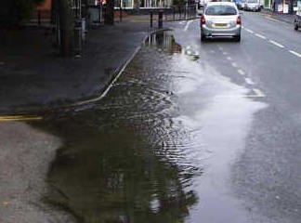

Slide 36
Land protected from compact growth protects the potential for annual recharge equivalent to
reducing water used by 65,000 households!
Equal water use for 107,000 households per year
Sprawl Growth within boundaries

Slide 37
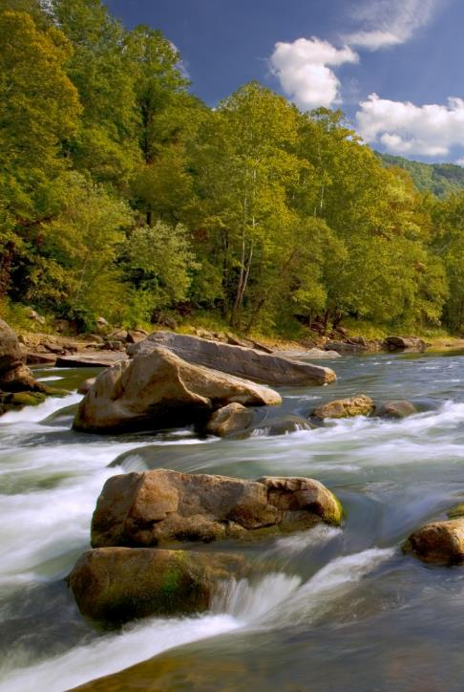
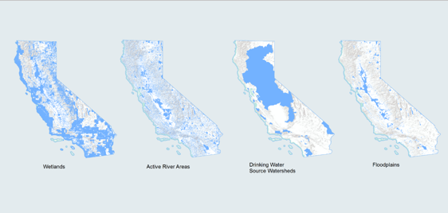
Water Hazard Risk Reduction

Slide 38
Water Resource priority Areas
Floodplains
750 fewer acres in the floodplain urbanized
Sprawl Growth within boundaries

Slide 39
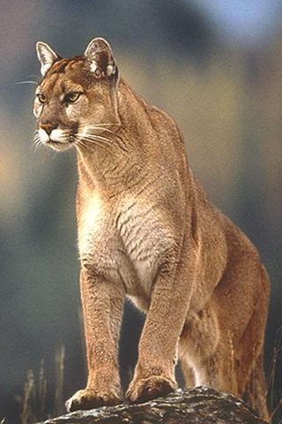
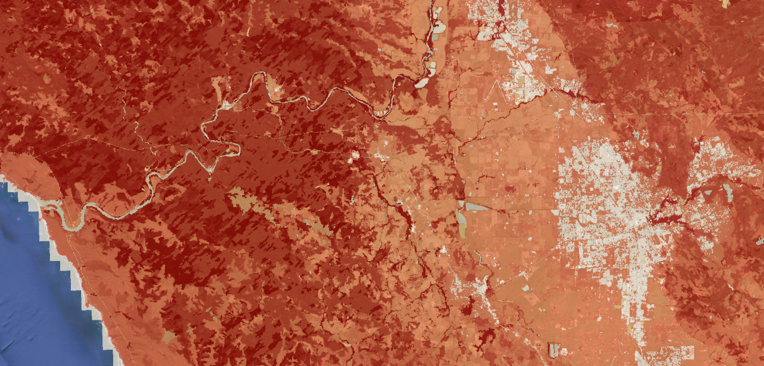
Habitat for Terrestrial Vertebrates
Terrestrial Habitat Conservation

Slide 40
Photo Source: CDWR
Photo © Doug Brown / Flickr through a Creative Commons license.
~16,000 acres of habitat protected
~10,000 acres of habitat protected

Slide 41
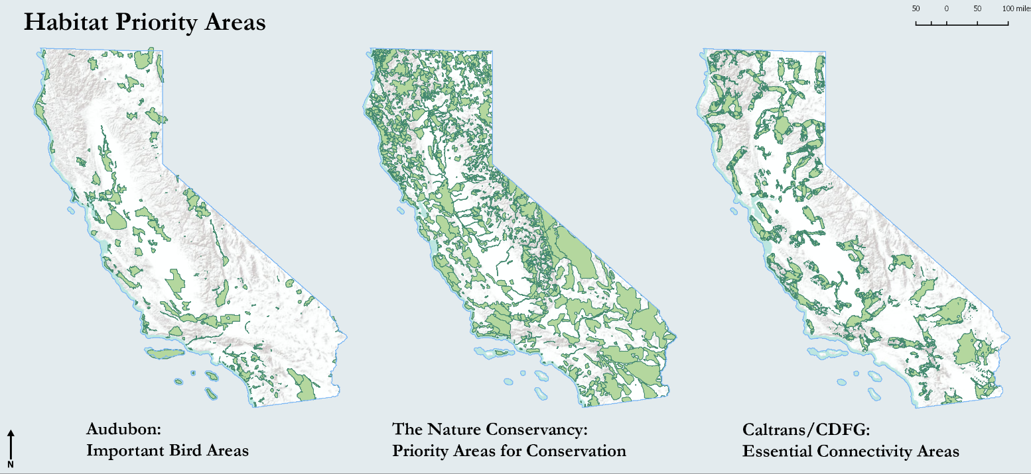
Habitat Priority Areas
Terrestrial Habitat Conservation

Slide 42
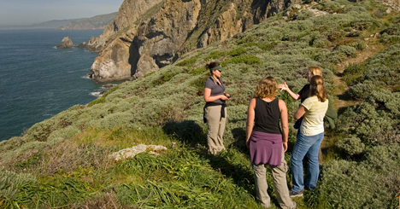
Compact growth saves 5000 acres that TNC may have otherwise needed to purchase
Sprawl Growth within boundaries

Slide 43
Compact growth in the Bay Area
Protects 5,000 acres in drinking water watersheds
Keeps 17,000 acres of land barrier free for wildlife movement
Protects 800 acres of wetlands
Keeps $8 million dollars of local agriculture in the economy

Slide 44
Did this work?
Notes:
Liz –
Ultimately our goal in developing this tool was to encourage sustainable growth that protects open space by revealing information on impacts to natural and agricultural resources. So, how did we do?
Greenbelt alliance presented these findings to ABAG and MTC staff and commissioners at public hearings, they used this information to write a letter from a coalition of 17 non-profit organizations and public agencies in support of a more compact growth pattern. And the incoming chair of MTC cited this work at public hearings. Based on this information – even the compact growth scenario which I shared with you today, was revised to further protect natural and agricultural lands by redirecting zoning for housing units that had significant imipacts to natural and agricultural resources. This new adjusted scenario formed the basis for Plan Bay Area 2040 – released this summer.
This was really cool for us to see that these metrics ARE in fact influencing decisions, and that there is receptivity for this type of information. We are very thankful to Greenbelt alliance for being the first users of this tool and using its metrics to effect change.

Slide 45
The path forward
Conservation Module
Water
Habitat
Agriculture
Carbon
Better land use decisions
You!
Open Source Code

Slide 46
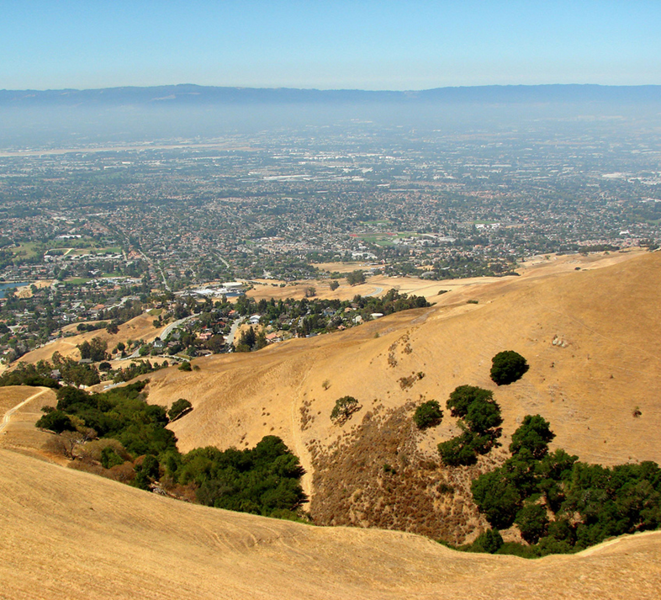
What does this mean for you?
Be a resource to your local planning agencies
Help communicate the benefits of natural and working lands to the community
Help promote compact growth

Slide 47
Thank you!
In appreciation:

